Slide 1
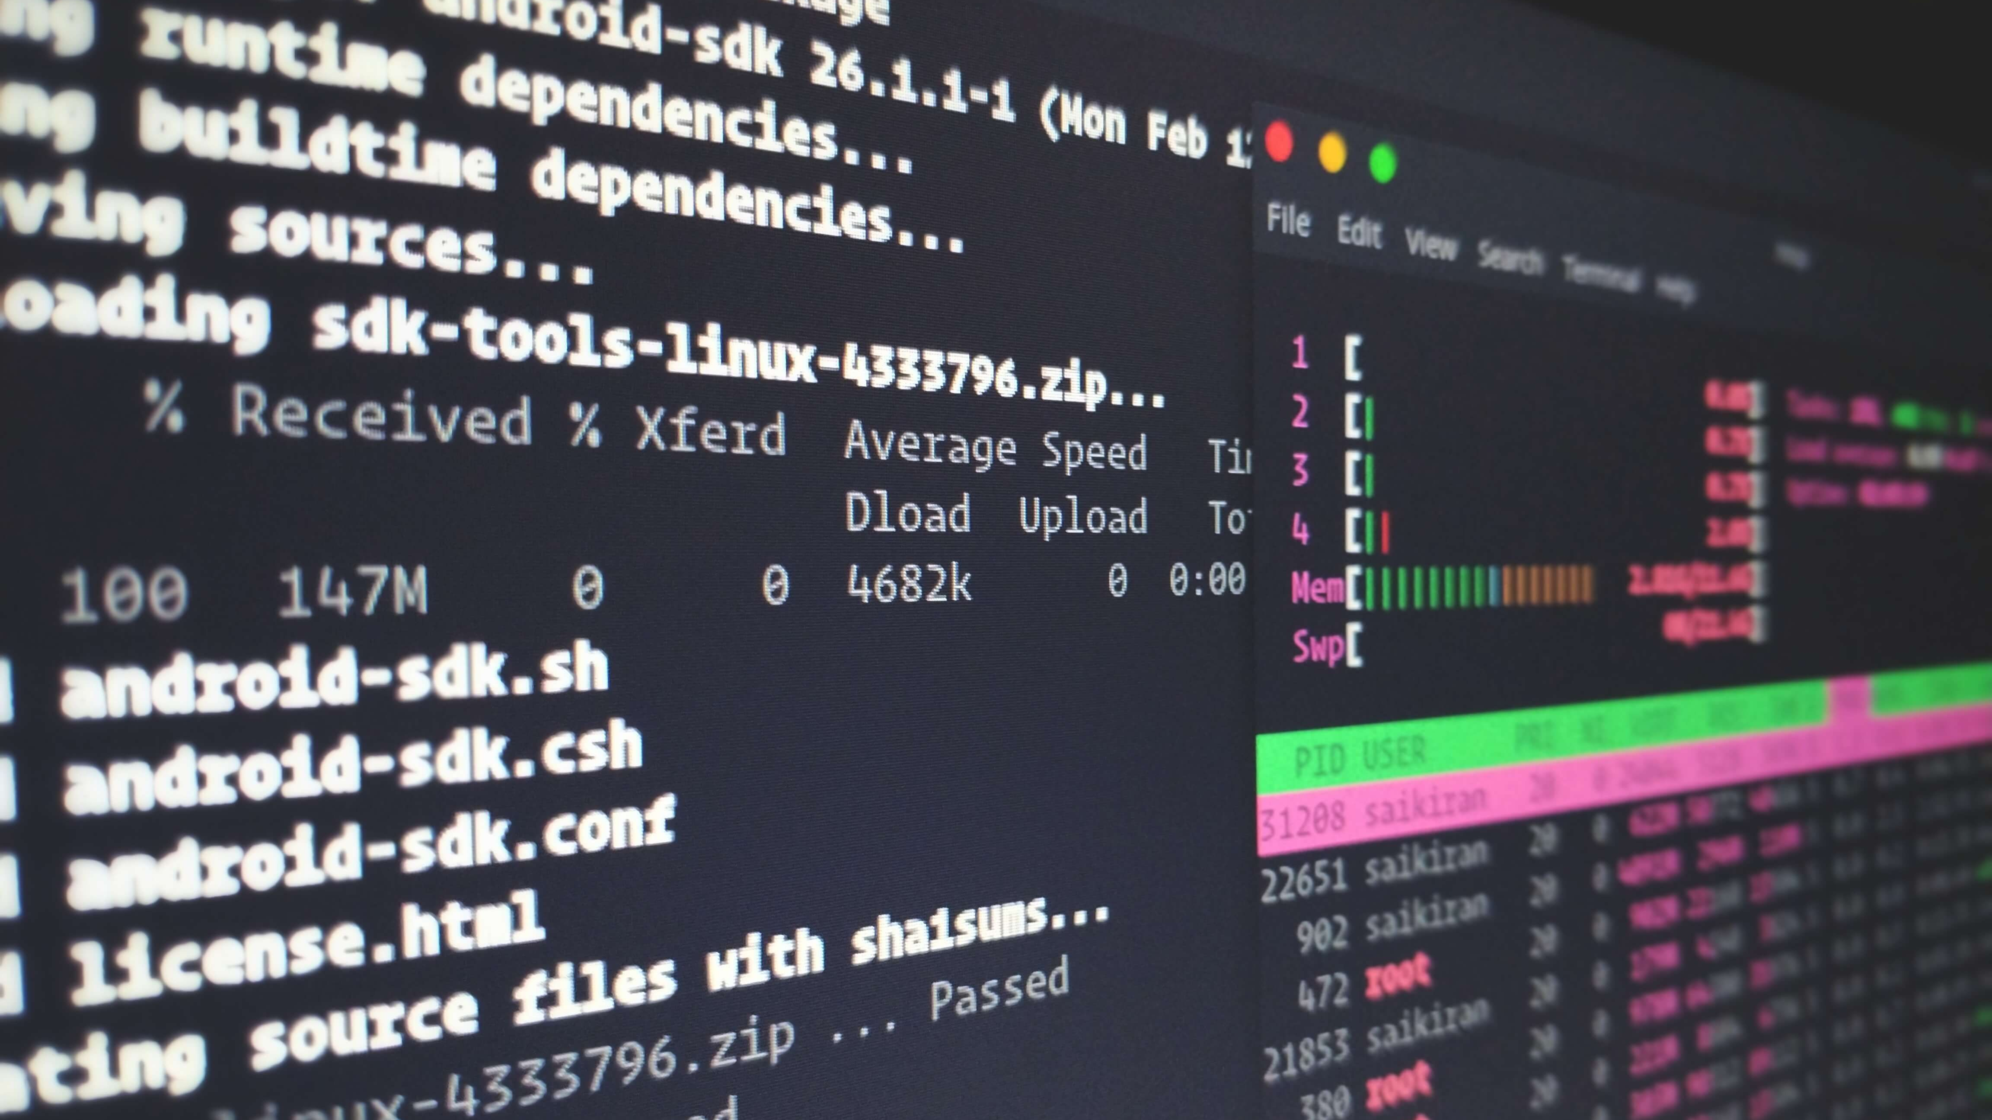
Lecture 9 : Command Line and Terminal Basics
Eng / Youssef khaled
Backend Roadmap

Slide 2
Introduction
What is the Command Line?
- Text-based interface for interacting with your computer
- Allows you to execute commands and scripts
Why is it Important for PHP Development?
- Efficient for managing files, running scripts, and automating tasks

Slide 3
Terminal vs. Command Line Interface (CLI)
Terminal
- The application you use to interact with the command line (e.g., Terminal on macOS, Command Prompt on Windows)
Command Line Interface (CLI)
- The environment or interface where you type commands

Slide 4

Basic Commands
Navigating Directories
- pwd - Print Working Directory
- ls - List Files and Directories
- cd <directory> - Change Directory
File Operations
- touch <file> - Create a New File
- mkdir <directory> - Create a New Directory
- rm <file> - Remove a File
- rmdir <directory> - Remove a Directory

Slide 5
File Manipulation
Viewing File Contents
- cat <file> - Display File Content
- more <file> - View File Content Page by Page
- less <file> - View File Content with Scroll
Editing Files
- Basic editors: nano, vim, vi

Slide 6

Running PHP Scripts
PHP Command Line Interface
- php <script.php> - Run a PHP Script
Common Commands
- php -v - Check PHP Version
- php -S localhost:8000 - Start a Built-in PHP Server

Slide 7

Understanding File Permissions
Viewing Permissions
ls -l - List Files with Permissions
Changing Permissions
- chmod <permissions> <file> - Change File Permissions (e.g., chmod 755 script.php)
Changing Ownership
- chown <user>:<group> <file> -Change File Ownership

Slide 8

Environment Variables
What Are Environment Variables?
- Variables that define system-wide settings
Viewing and Setting Environment Variables
- printenv - List Environment Variables
- export VAR_NAME=value - Set a New Environment Variable

Slide 9
Scripting and Automation
Creating Shell Scripts
- Basic syntax for creating a script (.sh files)
- Example: Simple PHP script runner
Running Shell Scripts
- sh <script.sh> - Execute a Shell Script

Slide 10
Best Practices
Script Organization
- Keep scripts well-organized and documented
Security
- Be cautious with file permissions and sensitive data
Efficiency
- Use aliases and scripts to automate repetitive tasks

Slide 11
Summary
Key Takeaways
- Importance of the command line in development
- Basic commands and operations
- Running PHP scripts and managing files
Further Learning
- Practice common commands
- Explore advanced command-line tools and scripting

Slide 12
Resources
Links for Further Reading
- Official PHP CLI Documentation: https://www.php.net/manual/en/features.commandline.php
- Linux Command Line Basics: https://www.codecademy.com/learn/learn-the-command-line
- Bash Scripting Guide: https://www.tldp.org/LDP/Bash-Beginners-Guide/html/

